Slide 1
Regression
IVU Model Development Training Course
June 2014
1
Notes:
1

Slide 2
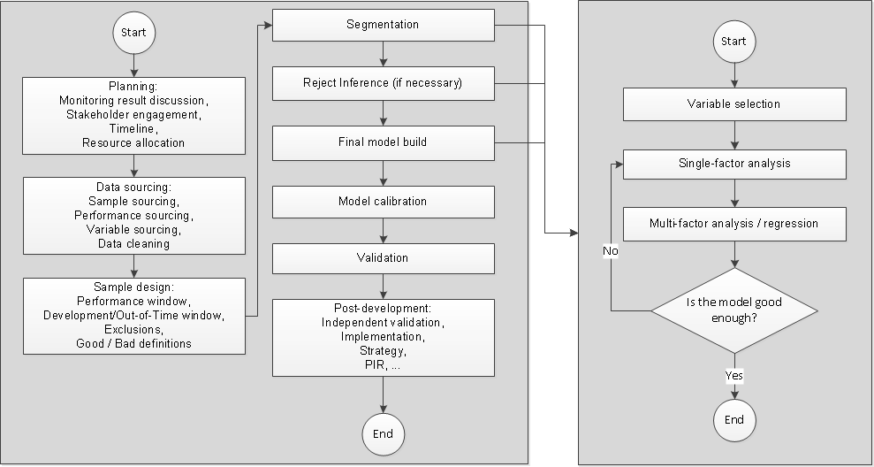
Scorecard development process
Full process
Modelling process

Slide 3
Agenda
Statistical learning 101
Data exploration and cleansing
Variable selection
Single factor analysis
Regression (multi factor analysis)

Slide 4
Statistical learning 101
Variable | Points
Age
18 to 37
38 to 57
58 +

